Slide 1
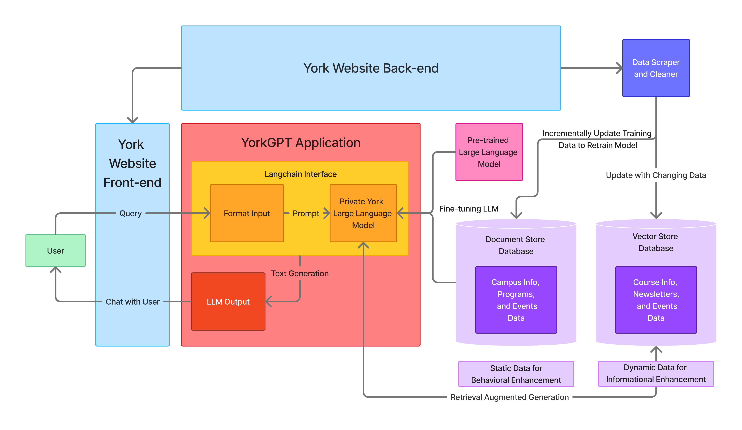
Data Integrity in Large Language Model Retrieval Augmented Generation
Darryl Nurse, Department of Computer Science and Math
Mentor: Dr. Abu Kamruzzaman, Department or Business and Economics
ABSTRACT
MATERIALS & METHODS
CONCLUSIONS
The focus of this research is to analyze the ability of Large Language Models (LLMs) to maintain data accuracy and integrity during Retrieval Augmented Generation. By investigating their capabilities to generate consistent information and assessing the success rate of factual data returned to the user, this project seeks to provide insight into the reliability of LLMs in text-based and chat-based contexts.
The OpenAI API is being used as an LLM to generate text, and Langchain as the interface to embed and query text documents. Results were produced using 8 text files containing random facts, 6 of which were the same recurring correct facts worded various ways, and 3 of which contained incorrect information following the same structure. A ratio of correct to incorrect files were determined as an experimental variable (ranging from 6 correct files and 0 incorrect files, to 3 correct files and 3 incorrect files. The prompt received queries related to information that the LLM was able to access as input, and the LLM was queried 50 times for each ratio. From these runs, the percentage of correct answers was derived.
After witnessing and analyzing the ability of the Large Language Model (LLM) to respond and incorporate new, unfamiliar data into its generated responses, it is clear that Retrieval Augmented Generation (RAG) is still a powerful tool in the sphere of Generative Artificial Intelligence and can serve to make up for informational scope where limited training of Models falls short. Additionally, with the consistent ability of the LLM to generate accurate and responses from this new information, RAG is still comparable in data integrity compared to continuously diversifying training data. Currently, continuous unsupervised retraining, where LLMs retrain themselves on new information they receive, might not be currently as feasible due to computational and experimental restraints. In systems with a continuous stream of new data, splitting of this data into documents, embedding it into vector store databases and retrieval with vector querying algorithms, combined with its ability to maintain data accuracy, RAG can serve to emulate a growing knowledge pool. This type of system is integral in the proposed YorkGPT application, where dynamic data sources must be factored into the text generation ability of the LLM-powered Chat Bot. However, as with all systems, limitations exist, and the LLM may eventually need to be retrained, to grow its behavioral efficiency. Additionally, a constantly growing retrieval source will consume large amounts of storage and could be expensive to maintain. As this research project continues and phases into implementation, these issues will be further addressed.
Prompt Engineering: Langchain’s prompt templating capabilities were used to pass system and user messages to the model to ensure its functionality within the constraint and parameters of the experiment.
Data Transformation: Reformatted and recursively split large raw text files, allowing information to be transformed into manageable chunks, ensuring efficient and concise retrieval by the models.
Vector Storage and Searching: Embedded transformed text data into a vector representation to store data in multi-dimensional data storage structure and utilized the Hierarchical Navigable Small World (HNSW) algorithm to perform time-efficient and precise approximate Nearest Neighbor Searching throughout the vector store.
OBJECTIVES
Ultimately, this study aims to produce quantifiable insights into the dependability, constraints, and range of Retrieval Augmented Generation in LLMs.
RESULTS
INTRODUCTION
By obtaining experimental runs in an average accuracy of around 70%, we can see that RAG can serve to bolster the ability of LLMs to generate both concise, but also updated data. This capability of Retrieval Augmentation is the basis of a proposed YorkGPT system, where continuous unsupervised retraining of LLMs is not practically or computationally viable. The YorkGPT system is scheduled to be developed and tested in Summer 2024 and launched to York website in Fall 2024.
Large Language Model(LLM)s lend themselves to be the most prominent applications of Generative Artificial Intelligence (Gen AI). These models are trained on vast amounts of textual data from various sources and can provide relational and semantic context between commonly occurring words, sentences and language structures. The textual data originates from existing websites, documents, books and articles, and serves as the scope of knowledge at which the LLM can operate. Vast sources of information allow them to emulate a broad spectrum of human language in various contexts. However, in a dynamic informational age, this has its limitations. To incorporate new data, models must be retrained, consuming further resources and posing a temporary solution. With Retrieval Augmented Generation (RAG), LLMs can draw data from sources they were not exposed to during training, enhancing their text generation capabilities and increasing the extent of their knowledge. While this great expanse of static and dynamic data sources may broaden the effective scope of text generation, it also poses a risk to the factuality of information.
REFERENCE
John Chung, Ece Kamar, and Saleema Amershi. 2023. Increasing Diversity While Maintaining Accuracy: Text Data Generation with Large Language Models and Human Interventions. In Proceedings of the 61st Annual Meeting of the Association for Computational Linguistics (Volume 1: Long Papers), pages 575–593, Toronto, Canada. Association for Computational Linguistics.
ACKNOWLEDGEMENTS & CONTACT
Figure: Hypothetical System Design for YorkGPT Private LLM powered with RAG
Thank you Dr. Kamruzzaman, you are a wonderful mentor and motivator. My Github and Linkedin are both darrylnurse.
Email: darryl.nurse@yorkmail.cuny.edu

